Slide 1


Economy: 6 pillars + theory + current + BES17 (pre cum Mains)
1.Banking, Fin, Insur.
6.HRD
2.Budget
3.BoP
4.Sectors
5.Infra
V1:c3,4
V1:c2,3, 6,9,11(GST),13
V1c:5
V1c:7,11(Agri)
V1c:10
v1c:12, 14; Budget^Rail

Slide 2
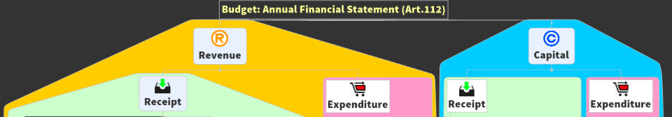
Annual Financial statement
112
AFS with revenue expenditure shown separately.
265
Finance Bill
266
Appropriation Bill
To collect taxes
To spend money from CFI
Parliament* (LS) Approval Necessary

Slide 3
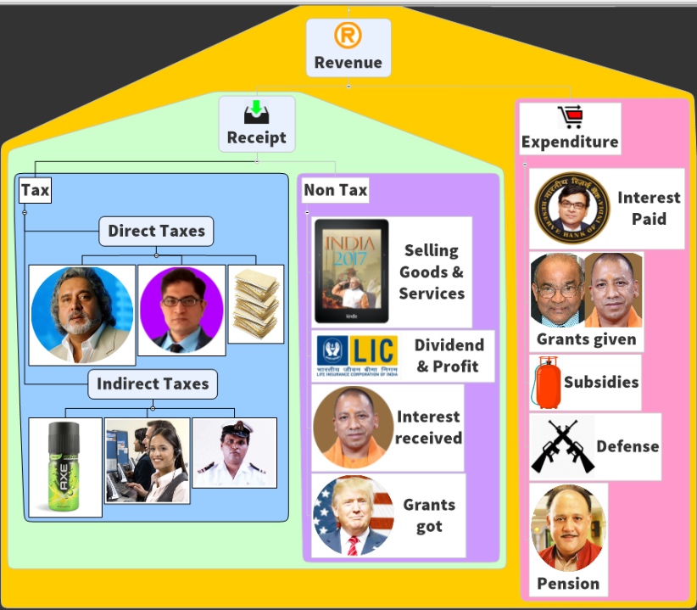
Art 112: Annual Financial Statement, with Revenue Expenditure shown separately.
Budget 2017
Decreasing
Decreasing order
Decreasing
Decreasing

Slide 4
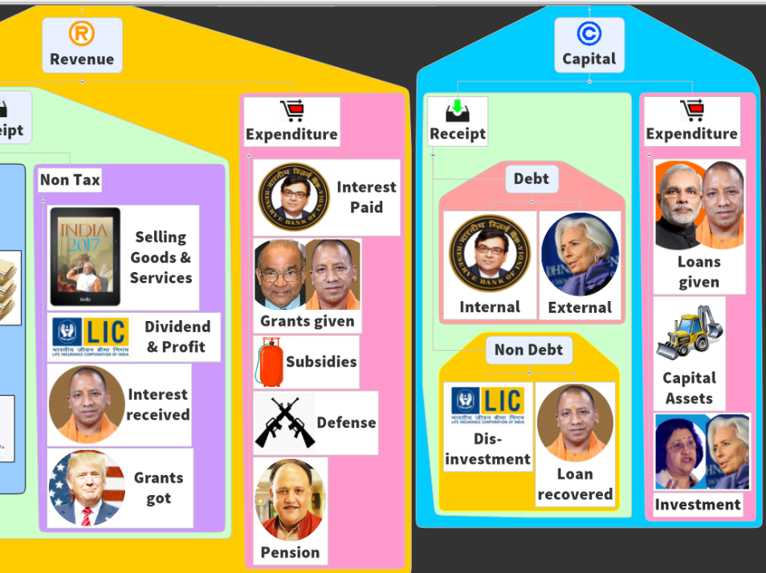
Budget (AFS)2017
Loan, finance, investment type things
Decreasing
Decreasing
Decreasing
Decreasing

Slide 5
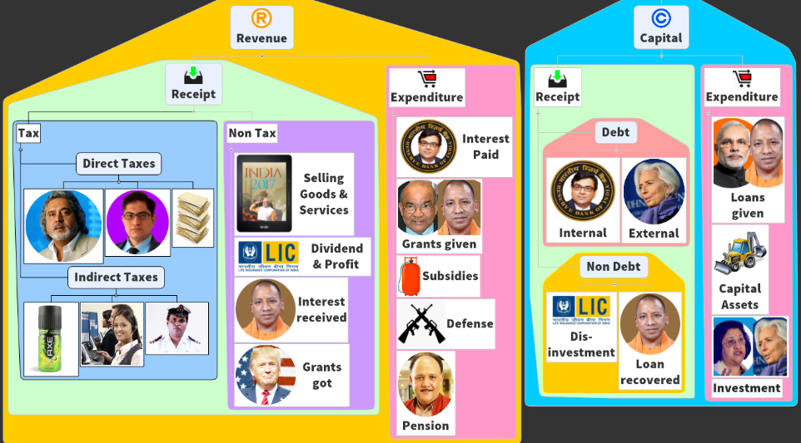
No tax without law
What if Rajya Sabha doesn’t approve?
Art.110 “Money Bill”: cat.”A”- Tax imposition, abolition, remission, alteration or regulation.
Finance bill = Money bill.
Art.109: Rajya Sabha can max. sit on it for 14 days. Can only “suggest” amendment, their approval (by LS) is not necessary.
Notes:
Article 110 in The Constitution Of India 1949
110. Definition of Money Bill(1) For the purposes of this Chapter, a Bill shall be deemed to be a Money Bill if it contains only provisions dealing with all or any of the following matters, namely(a) the imposition, abolition, remission, alteration or regulation of any tax;
(b) the regulation of the borrowing of money or the giving of any guarantee by the Government of India, or the amendment of the law with respect to any financial obligations undertaken or to be undertaken by the Government of India;
(c) the custody of the consolidated Fund or the Contingency Fund of India, the payment of moneys into or the withdrawal of moneys from any such Fund;
(d) the appropriation of moneys out of the consolidated Fund of India;
(e) the declaring of any expenditure to be expenditure charged on the Consolidated Fund of India or the increasing of the amount of any such expenditure;
(f) the receipt of money on account of the Consolidated Fund of India or the public account of India or the custody or issue of such money or the audit of the accounts of the Union or of a State; or
(g) any matter incidental to any of the matters specified in sub clause (a) to (f)
(2) A Bill shall not be deemed to be a Money Bill by reason only that it provides for the imposition of fines or other pecuniary penalties, or for the demand or payment of fees for licences or fees for services rendered, or by reason that it provides for the imposition, abolition, remission, alteration or regulation of any tax by any local authority or body for local purposes
(3) If any question arises whether a Bill is a Money Bill or not, the decision of the Speaker of the House of the People thereon shall be final
(4) There shall be endorsed on every Money Bill when it is transmitted to the Council of States under Article 109, and when it is presented to the President for assent under Article 111, the certificate of the Speaker of the House of the People signed by him that it is a Money Bill

Slide 6
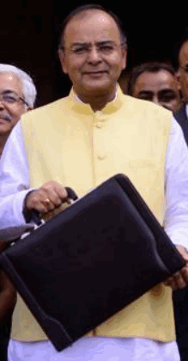


Finance bill = Money bill, Rajya Sabha approval not necessary.
Finance bill 2017
Income tax _%, service tax _% AND Snow leopard will be our national Animal (!)
Amend
BUT?
RBI Act 34: electoral bond
Tribunal Acts..
Central Excise Act, 1944 Gutkha ▲
Customs Act, 1962: renewal energy part ▼
IT Act 1961: 10%->5%
RPA Act 51: E-Bond use

Slide 7
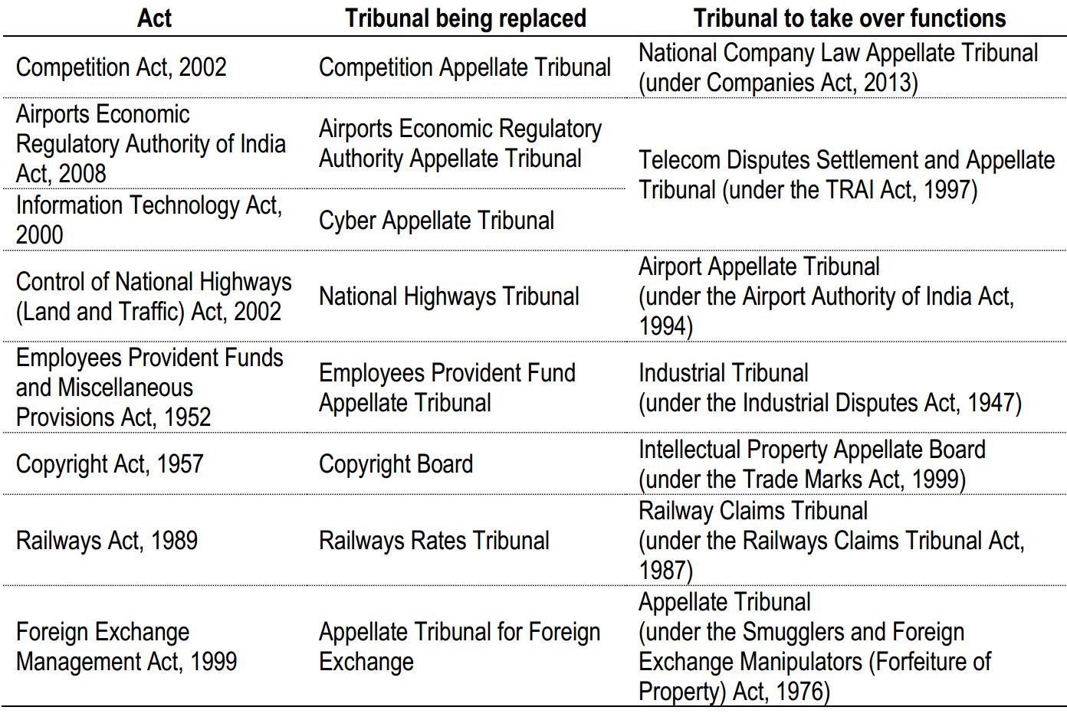


Finance bill = Money bill, Rajya Sabha approval not necessary.
Judiciary's power of appointment curtailed.
Retired judges in all tribunals have same salary. Etc…
Opposition: <not tax things> added in Fin Bill, to evade Rajya Sabha scrutiny.

Slide 8
Change Income tax rates= ok but change IT “Administrative procedures”..?!
Finance bill
IT officials can search / seize premise, on "tip". Don't have to disclose "tip" to any court / tribunal.
IT officials can raid charitable institutes.
1+2 = harassment of political parties and individuals. [retrospectively, from 1975!]
IT officials can 'seize' assets for 6 months on "tip": extortion.
Adhar Compulsory for IT filing. But SC said not mandatory?
3 lakh cash limit-> 2 lakh cash limit.
As these amendment to income tax act, clubbed in “finance bill” to evade Rajya Sabha scrutiny.

Slide 9
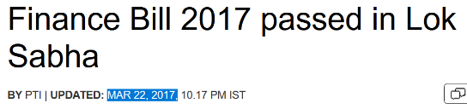
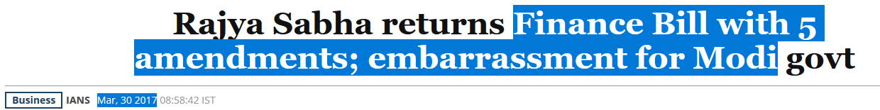
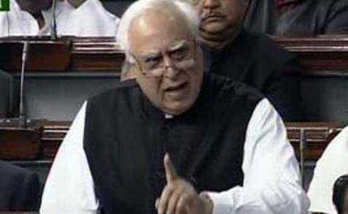
Even Post-Demonetization, didnot allow Parliament to function. Kaam Kru toh kaise? इसलिए दे-ठोक Finance Bill से दुसरे कानूनों में amendment कोरबे चालो!
Finance bill 2017 “Bypass surgery” to avoid Rajya Sabha scrutiny. 40 amendments to various acts!!

Slide 10


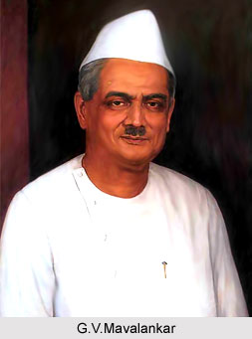

So what’s the controversy?
Rule 219 of the Lok Sabha: Finance bill = financial proposals for upcoming year, temporary in nature. E.g.
First IT Slab: 10% ->5% for FY 2017-18.
Money Bill Art 110:
Tax
CFI $$ [deposit, Expenditure].
Rajya Sabha passing.
Keep Only taxation proposals in finance bill. Don't add non-fiscal, non-incidental proposals. Only then its money bill.

Slide 11
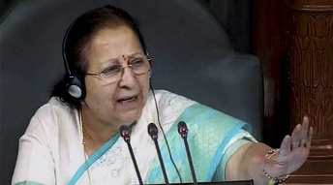
But who will decide ke Finance Bill= Money bill hai ki nhi?
Money Bill Art 110:
Tax
CFI $$ [deposit, Expenditure].
Art.110 (3): LS Speaker's decision final, whether bill is money bill or not.
: Finance Bill 2017 is a money bill. Non-tax proposals are "incidental" so permitted under rules. [tax = black money; tribunal= expenditure]
Art.122: courts can't enquire into the validity of the proceedings of the Parliament.
Notes:
Money bill: 1) Tax 2) CFI $$ [credit, debit]. At max, Rajya Sabha can "sit" on it for 14 days, and only "Suggest" amendments. LS not bound.
Rule 219 of the Lok Sabha: Finance bill = financial proposals for upcoming year, temporary in nature.
GV Mavalankar (1st speaker): Keep Only taxation proposals in finance bill. Don't add non-fiscal, non-incidental proposals. Only then its money bill.
Art.110 (3): LS Speaker's decision final, whether bill is money bill or not.
LS Speaker Sumitra Mahajan: Finance Bill 2017 is a money bill. Non-tax proposals are "incidental" so permitted under rules.
Art.122: courts can't enquire into the validity of the proceedings of the Parliament.
Earlier Aadhaar (Targeted Delivery of Financial and Other Subsidies, Benefits and Services) Bill, 2016 as a Money Bill. <more under subsidies>

Slide 12
Annual Financial statement
112
AFS with revenue expenditure shown separately.
265
Finance Bill
266
Appropriation Bill
To collect taxes
To spend money from CFI
Parliament* (LS) Approval Necessary

Slide 13


“Sarkaari Tijori”: Consolidated Fund of India <Art. 266> basically, all incoming Rs. related to loans and taxes.
Surcharge
Education Cess
All the loans raised.
All the loans recovered.
+Cess: Swatch Bharat, Krishi Kalya, Clean Energy
Notes:
Withdrawal need Parliament Permission (- Charged Expenditure)

Slide 14

CGA will workout how much money required from CFI?
fin.min
Economic Affairs
Expenditure
Revenue [CBDT, CBEC]
Financial services [JDY, JJ..]
Disinvestment Investment & Public Asset Management
Budget, Survey
Small Savings [8+1]
ICAS via UPSC-CSE
I also “play” for the country! But toppers don’t give first preference ☹
Renamed in Budget 2016

Slide 15
Why Appropriation Bill by CGA ► FinMin?
114/3: To withdraw the passed money by Lok Sabha
266: no money out of CFI without law
Estimated Expenditure from Consolidated fund
Demand of Grants
Only with President recommendation: 113/3
Charged Expenditure
Voting nope (Art.113/1)
Loksabha can approve, reject, reduce: 113/2
Discussion yes, possible in both houses
Separate for Ministries, States &UT, UT w.o.Legislature
Consolidated Fund-266
Contingency Fund-267
Public Account-266

Slide 16

Charged items on consolidated fund of each…
Union budget
Constitutional posts, their office maintenance
State budget
UT
Administrator, Judicial commissioner
Debt charges / loan repayment/interest, $ required to satisfy court judgement/decree
SC: salary, allowance, Pensions
Similar to above
Speaker, Dy. In both houses- Salary, allowance
Any other item declared by parliament
+ similar to above
Charged items
Can be discussed
Can’t be voted
In Goa, Diu & Daman- ‘63
Highest civil & criminal court;
Appeal ►Bombay HC ►SC

Slide 17
“Sarkaari Tijori”: Consolidated Fund of India <Art. 266> basically, all incoming Rs. related to loans and taxes.
Surcharge
Education Cess
All the loans raised.
What if Rajya Sabha doesn’t approve?
Art.110 “Money Bill”: (d) appropriation of money out of CFI, (e) “Charged Expenditure”
Appropriation bill = Money bill. <Earlier “Snow Leopard”: Aadhar Targeted Subsidies Bill 2016>
Art.109: Rajya Sabha can max. sit on it for 14 days. Their approval is not necessary.
All the loans recovered.
+Cess: Swatch Bharat, Krishi Kalya, Clean Energy
Notes:
Withdrawal need Parliament Permission (- Charged Expenditure)

Slide 18
Tax, loan related money goes in Sarkari Tijori #1 (CFI) what about money coming from other sources?Ans. Art. 266 (Public Account)
Edu Cess: Prarambhik Shiksha Kosh (HRD, Nonlapse) SSA+MDM
SSS: National small savings fund (NSSF)
Money order
National Investment Fund (NIF)
Notes:
Withdrawal need Parliament Permission (- Charged Expenditure)
In view of the difficult economic situation caused by the global slowdown of 2008-09 and a severe drought in 2009-10, Government approved a change in the policy for utilization of disinvestment proceeds (5th of November 2009) by granting a one-time exemption to utilize the disinvestment proceeds directly for selected Social Sector Schemes allocated by Department of Expenditure/ Planning Commission. This exemption was to be operational for the period April 2009-March 2012. In view of the persistent difficult condition of the economy, the exemption from channelizing the disinvestment proceeds in the NIF was further extended by another year i.e. from April 2012 to March 2013
In order to align the NIF with the disinvestment Policy, Government decided (17th January 2013) that the disinvestment proceeds, with effect from the fiscal year 2013-14, will be credited to the existing NIF which is a ‘Public Account’ under the Government Accounts and the funds would remain there until withdrawn/invested for the approved purposes. It was also simultaneously decided that the NIF would be utilized for the following purposes:

Slide 19
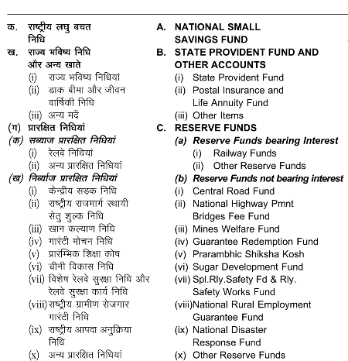
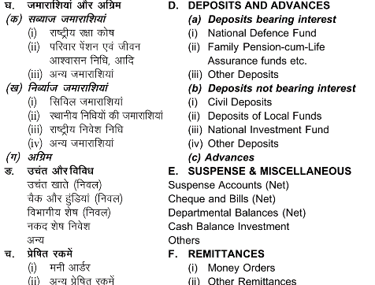
Art. 266: Public account: components of..

Slide 20


AFS will show Income & Expenditure in these three accounts:
Consolidated Fund-266: एकत्रित/संचित निधि
Incoming Revenue, loans raised, loans recovered
Public Account-266: लोकलेखा/जाहेर हिसाब
Contingency Fund-267: आकस्मिकता निधि
Unforeseen events Rs.500 cr. President (FinSecy)
Withdrawal need Parliament Permission (- Charged Expenditure)
Parliament approval “subsequently” obtained, after Expenditure
Govt. acts as banker: Incoming provident, small savings, postal deposit etc. parliament permission not necessary.
IF separate fund for specific expenditure need parliament permission to “Create” it e.g. road, mid-day meals. (IYB ch. On finance)
Refilling needs parliament permission

Slide 21
Annual Financial statement
112
AFS with revenue expenditure shown separately.
265
Finance Bill
266
Appropriation Bill
To collect taxes
To spend money from CFI
Parliament* (LS) Approval Necessary

Slide 22
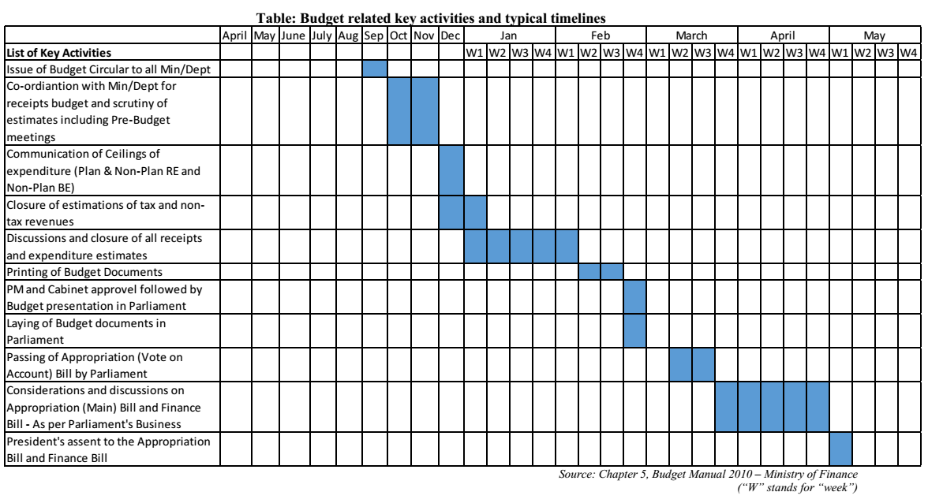
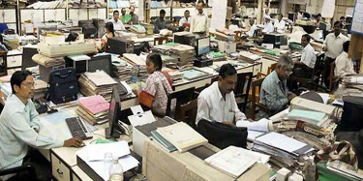
Vote on account: what and why?
Present: FEB W4
Vote on Account
New FY starts
Assent: May W1

Slide 23
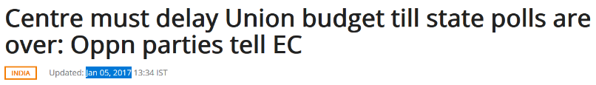
But now we advanced the budget presentation to 1st Feb 2017!
New FY starts, no need for Vote on account
Present: FEB W1
Assent: by March W3

Slide 24
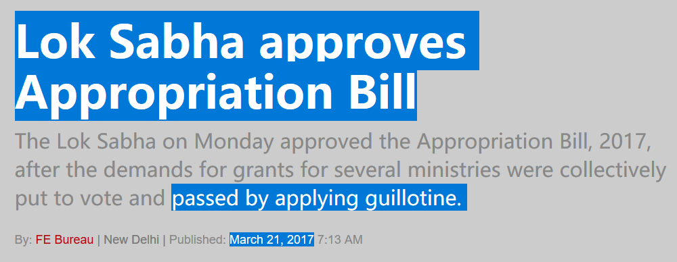
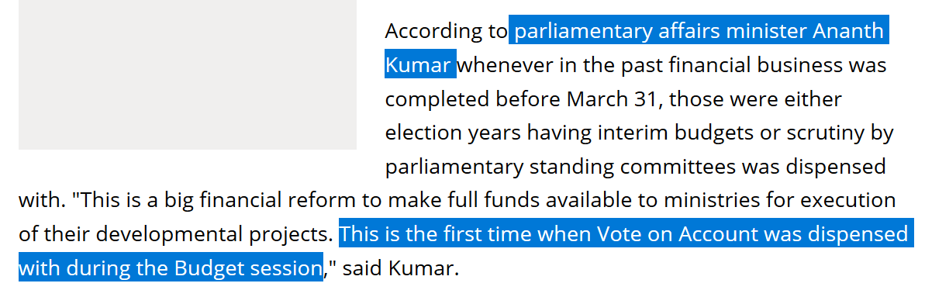
Read Laxmikanth
Notes:
http://www.business-standard.com/article/politics/parliament-s-budget-session-ends-gst-tops-the-list-of-18-bills-passed-117041200948_1.html
http://www.thehansindia.com/posts/index/National/2017-04-09/Arun-Jaitley-gets-appreciation-from-the-President-for-finishing-budget-process-by-31-March/292208

Slide 25
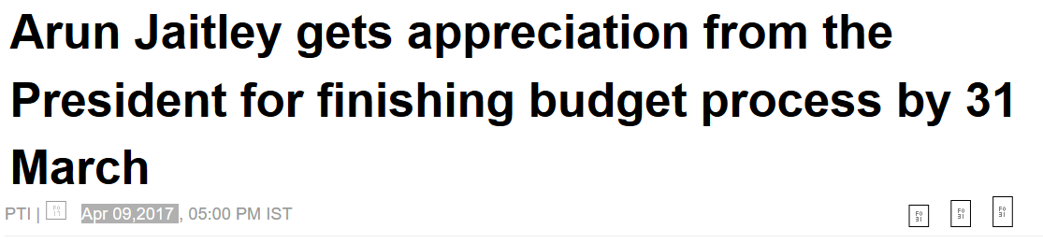
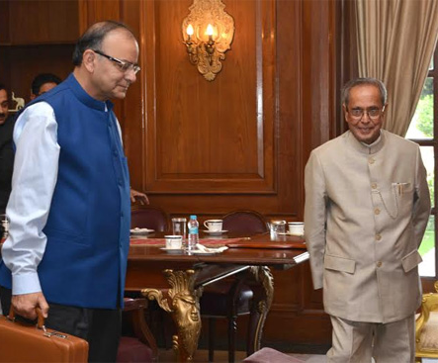
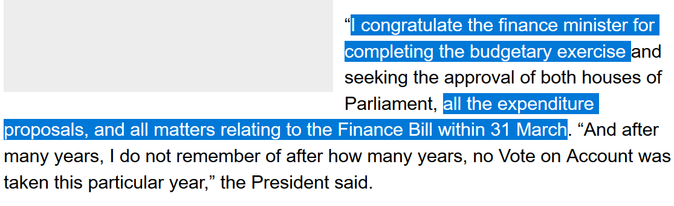
Budget
Finance bill
Appropriation Bill
Vote on Account
AFS
Become “ACT” after signature of President
शाबाश मेरे चीते!

Slide 26
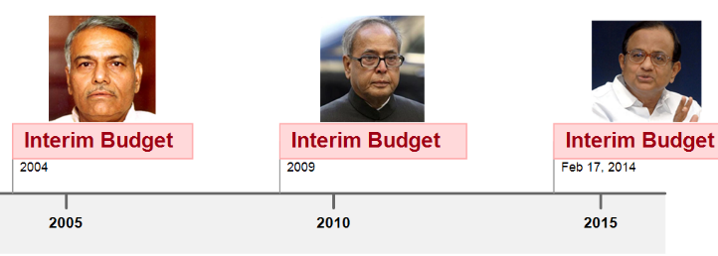
What’s the difference?
Vote on Account
Every year for cash problem between Feb to April when budget is passed
Interim Budget
Only Appropriation Expenditure permission
Election /extreme situation when immoral for outgoing Government to make drastic changes.
Valid: 2-4 months
All 3 docx + vote on account
Valid-whole year, unless changed by new govt.

Slide 27
Annual Financial Statement
Under our Constitution
Show past year’s revenue Expenditure separately. No compulsion to put plan vs non-plan budget
No compulsion to put separate rail budget
No compulsion to put budget on Feb W4

Slide 28
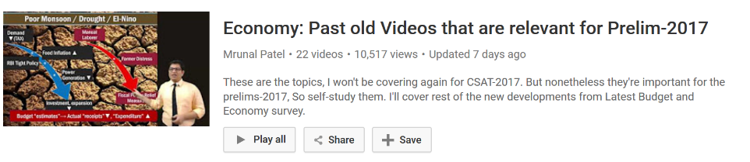
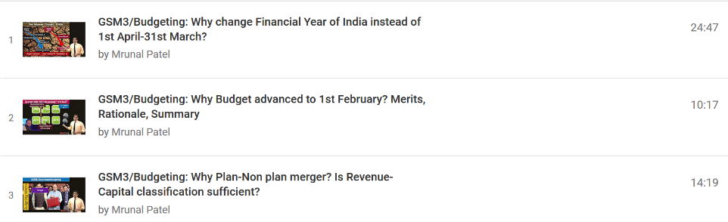
Self study videos: Playlist LINK
Ex-Chief Economic Advisor Shankar Acharya Committee.
Report given, and under consideration.
Steps of passing budget
Scrutiny by parliamentary Committees
Type of grants Etc.
read from M.Laxmikanth ch. On parliament.

Slide 29
Budget ► Revenue ► Receipt ► Tax
NEXT PART

